Slide 1
Distance and Similarity Measures
Bamshad Mobasher
DePaul University

Slide 2
Distance or Similarity Measures
Many data mining and analytics tasks involve the comparison of objects and determining in terms of their similarities (or dissimilarities)
  Clustering
  Nearest-neighbor search, classification, and prediction
  Characterization and discrimination
  Automatic categorization
  Correlation analysis
Many of todays real-world applications rely on the computation similarities or distances among objects
  Personalization
  Recommender systems
  Document categorization
  Information retrieval
  Target marketing

Slide 3
Similarity and Dissimilarity
Similarity
  Numerical measure of how alike two data objects are
  Value is higher when objects are more alike
  Often falls in the range [0,1]
Dissimilarity (e.g., distance)
  Numerical measure of how different two data objects are
  Lower when objects are more alike
  Minimum dissimilarity is often 0
  Upper limit varies
Proximity refers to a similarity or dissimilarity

Slide 4
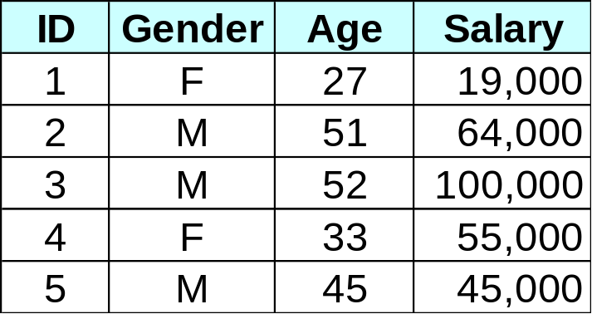
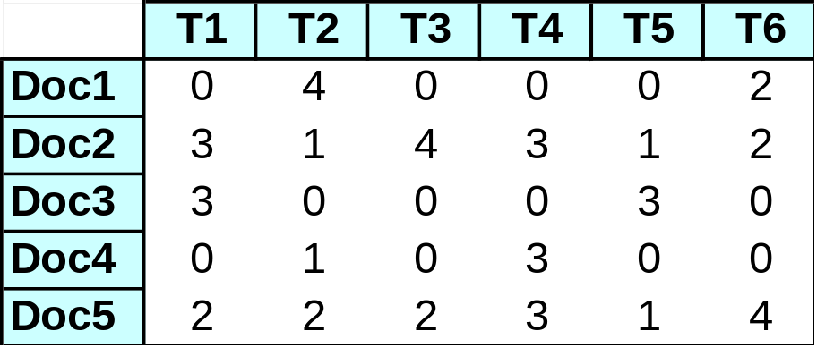
Distance or Similarity Measures
Measuring Distance
  In order to group similar items, we need a way to measure the distance between objects (e.g., records)
  Often requires the representation of objects as “feature vectors”
An Employee DB
Term Frequencies for Documents
Feature vector corresponding to
Employee 2: <M, 51, 64000.0>
Feature vector corresponding to Document 4:
<0, 1, 0, 3, 0, 0>

Slide 5
Distance or Similarity Measures
Properties of Distance Measures:
  for all objects A and B, dist(A, B) ≥ 0, and dist(A, B) = dist(B, A)
  for any object A, dist(A, A) = 0
  dist(A, C) ≤ dist(A, B) + dist (B, C)
Representation of objects as vectors:
  Each data object (item) can be viewed as an n-dimensional vector, where the dimensions are the attributes (features) in the data
  Example (employee DB): Emp. ID 2 = <M, 51, 64000>
  Example (Documents): DOC2 = <3, 1, 4, 3, 1, 2>
  The vector representation allows us to compute distance or similarity between pairs of items using standard vector operations, e.g.,
    Cosine of the angle between vectors
    Manhattan distance
    Euclidean distance
    Hamming Distance

Slide 6


Data Matrix and Distance Matrix
Data matrix
  Conceptual representation of a table
    Cols = features; rows = data objects
  n data points with p dimensions
  Each row in the matrix is the vector
  representation of a data object
Distance (or Similarity) Matrix
  n data points, but indicates only the
  pairwise distance (or similarity)
  A triangular matrix
  Symmetric

Slide 7

Proximity Measure for Nominal Attributes
If object attributes are all nominal (categorical), then proximity measure are used to compare objects
Can take 2 or more states, e.g., red, yellow, blue, green (generalization of a binary attribute)
Method 1: Simple matching
  m: # of matches, p: total # of variables
Method 2: Convert to Standard Spreadsheet format
  For each attribute A create M binary attribute for the M nominal states of A
  Then use standard vector-based similarity or distance metrics

Slide 8
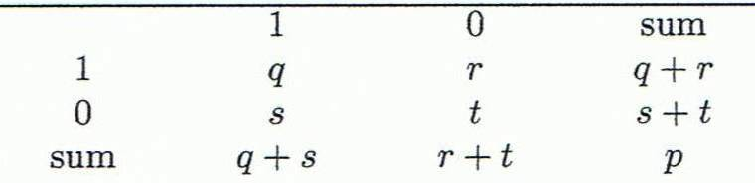
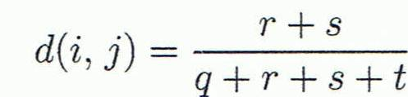
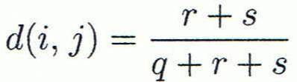

Proximity Measure for Binary Attributes
Object j
A contingency table for binary data
Distance measure for symmetric binary variables
Distance measure for asymmetric binary variables
Jaccard coefficient (similarity measure for asymmetric binary variables)
Object i

Slide 9
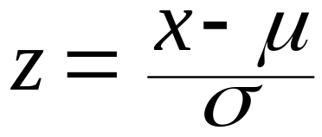

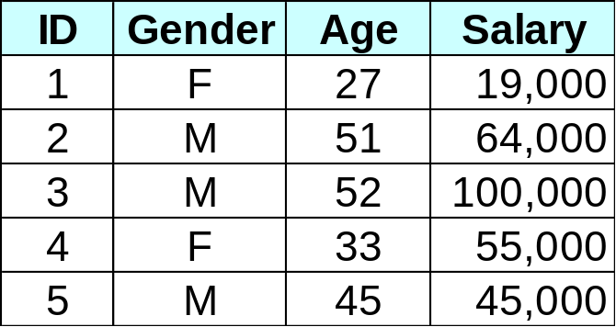
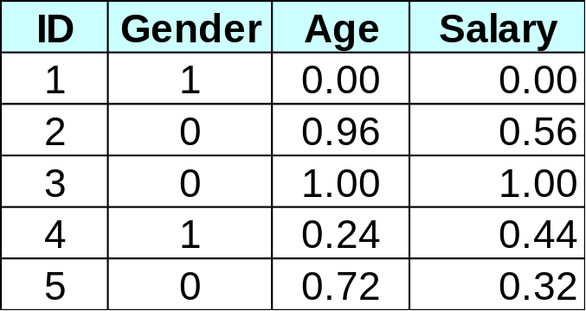
Normalizing or Standardizing Numeric Data
Z-score:
  x: raw value to be standardized, μ: mean of the population, σ: standard deviation
  the distance between the raw score and the population mean in units of the standard deviation
  negative when the value is below the mean, “+” when above
Min-Max Normalization

Slide 10



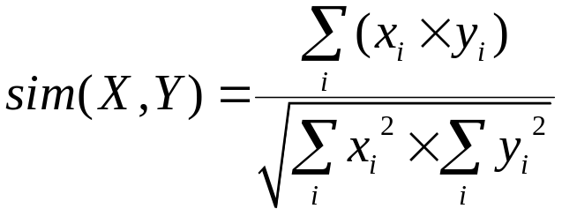

Common Distance Measures for Numeric Data
Consider two vectors
  Rows in the data matrix
Common Distance Measures:
  Manhattan distance:
  Euclidean distance:
  Distance can be defined as a dual of a similarity measure

Slide 11
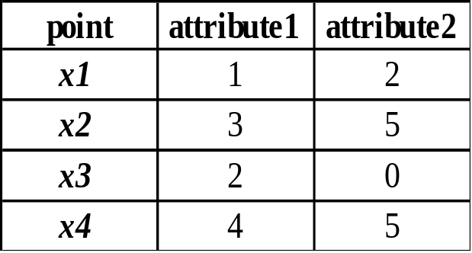
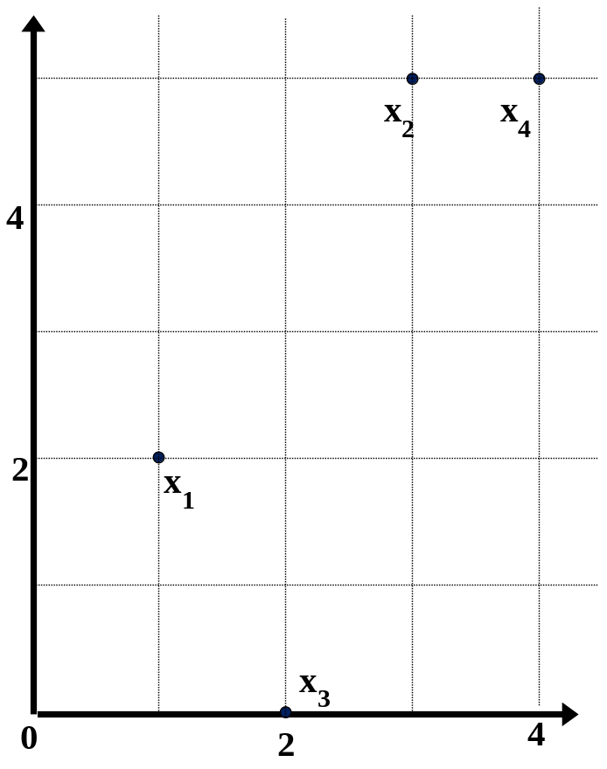
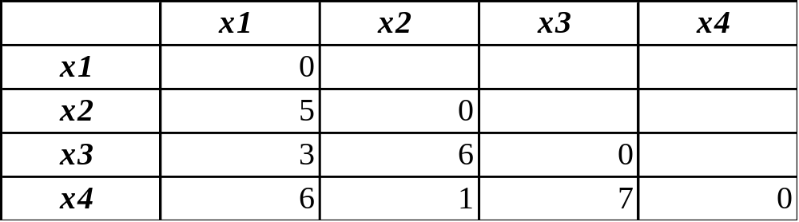
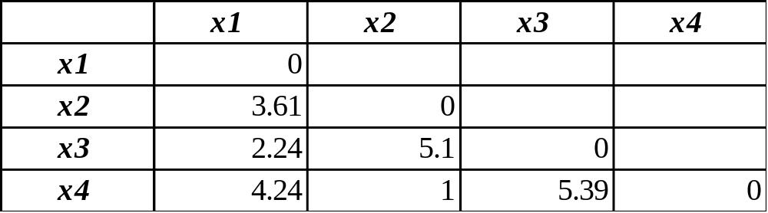
Example: Data Matrix and Distance Matrix
Data Matrix
Distance Matrix (Manhattan)
Distance Matrix (Euclidean)

Slide 12

Distance on Numeric Data:
Minkowski Distance
Minkowski distance: A popular distance measure
  where i = (x_{i1}, x_{i2}, …, x_{ip}) and j = (x_{j1}, x_{j2}, …, x_{jp}) are two p-dimensional data objects, and h is the order (the distance so defined is also called L-h norm)
Note that Euclidean and Manhattan distances are special cases
  h = 1: (L₁ norm) Manhattan distance
  h = 2: (L₂ norm) Euclidean distance

Slide 13


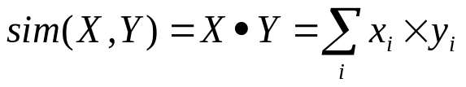
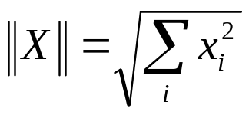
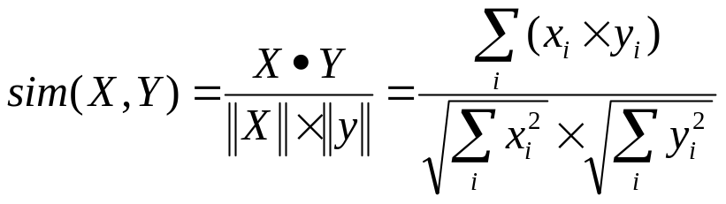
Vector-Based Similarity Measures
In some situations, distance measures provide a skewed view of data
  E.g., when the data is very sparse and 0’s in the vectors are not significant
  In such cases, typically vector-based similarity measures are used
  Most common measure: Cosine similarity
  Dot product of two vectors:
  Cosine Similarity = normalized dot product
  the norm of a vector X is:
  the cosine similarity is:

Slide 14
Vector-Based Similarity Measures
Why divide by the norm?
  Example:
    X = <2, 0, 3, 2, 1, 4>
    ||X|| = SQRT(4+0+9+4+1+16) = 5.83
    X* = X / ||X|| = <0.343, 0, 0.514, 0.343, 0.171, 0.686>
  Now, note that ||X*|| = 1
  So, dividing a vector by its norm, turns it into a unit-length vector
  Cosine similarity measures the angle between two unit length vectors (i.e., the magnitude of the vectors are ignored).

Slide 15
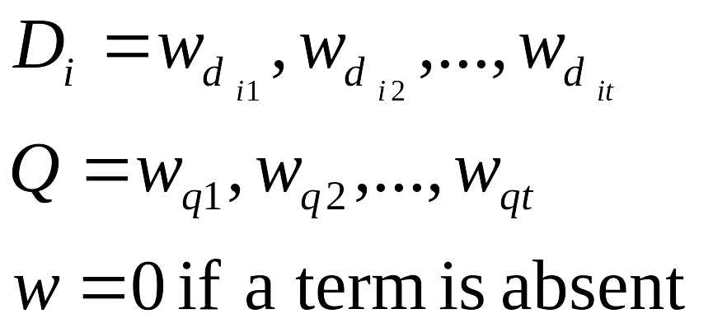
Example Application: Information Retrieval
Documents are represented as “bags of words”
Represented as vectors when used computationally
  A vector is an array of floating point (or binary in case of bit maps)
  Has direction and magnitude
  Each vector has a place for every term in collection (most are sparse)
Document Ids
a document
vector
nova galaxy heat actor film role
A 1.0 0.5 0.3
B 0.5 1.0
C 1.0 0.8 0.7
D 0.9 1.0 0.5
E 1.0 1.0
F 0.7
G 0.5 0.7 0.9
H 0.6 1.0 0.3 0.2
I 0.7 0.5 0.3

Slide 16
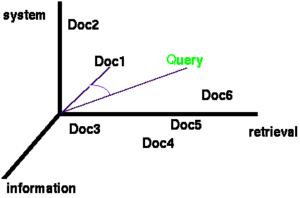
Documents & Query in n-dimensional Space
Documents are represented as vectors in the term space
  Typically values in each dimension correspond to the frequency of the corresponding term in the document
Queries represented as vectors in the same vector-space
Cosine similarity between the query and documents is often used to rank retrieved documents

Slide 17
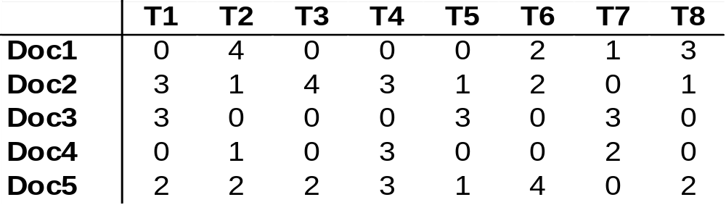
Example: Similarities among Documents
Consider the following document-term matrix
Dot-Product(Doc2,Doc4) = <3,1,4,3,1,2,0,1> * <0,1,0,3,0,0,2,0>
0 + 1 + 0 + 9 + 0 + 0 + 0 + 0 = 10
Norm (Doc2) = SQRT(9+1+16+9+1+4+0+1) = 6.4
Norm (Doc4) = SQRT(0+1+0+9+0+0+4+0) = 3.74
Cosine(Doc2, Doc4) = 10 / (6.4 * 3.74) = 0.42

Slide 18

Correlation as Similarity
In cases where there could be high mean variance across data objects (e.g., movie ratings), Pearson Correlation coefficient is the best option
Pearson Correlation
Often used in recommender systems based on Collaborative Filtering

Slide 19
Distance-Based Classification
Basic Idea: classify new instances based on their similarity to or distance from instances we have seen before
  also called “instance-based learning”
Simplest form of MBR: Rote Learning
  learning by memorization
  save all previously encountered instance; given a new instance, find one from the memorized set that most closely “resembles” the new one; assign new instance to the same class as the “nearest neighbor”
  more general methods try to find k nearest neighbors rather than just one
  but, how do we define “resembles?”
MBR is “lazy”
  defers all of the real work until new instance is obtained; no attempt is made to learn a generalized model from the training set
  less data preprocessing and model evaluation, but more work has to be done at classification time

Slide 20

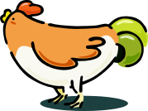




Nearest Neighbor Classifiers
Basic idea:
  If it walks like a duck, quacks like a duck, then it’s probably a duck
Compute Distance
Test Record
Training Records
Choose k of the “nearest” records

Slide 21
K-Nearest-Neighbor Strategy
Given object x, find the k most similar objects to x
  The k nearest neighbors
  Variety of distance or similarity measures can be used to identify and rank neighbors
  Note that this requires comparison between x and all objects in the database
Classification:
  Find the class label for each of the k neighbor
  Use a voting or weighted voting approach to determine the majority class among the neighbors (a combination function)
    Weighted voting means the closest neighbors count more
  Assign the majority class label to x
Prediction:
  Identify the value of the target attribute for the k neighbors
  Return the weighted average as the predicted value of the target attribute for x

Slide 22

K-Nearest-Neighbor Strategy
K-nearest neighbors of a record x are data points that have the k smallest distance to x

Slide 23
Combination Functions
Voting: the “democracy” approach
  poll the neighbors for the answer and use the majority vote
  the number of neighbors (k) is often taken to be odd in order to avoid ties
    works when the number of classes is two
    if there are more than two classes, take k to be the number of classes plus 1
Impact of k on predictions
  in general different values of k affect the outcome of classification
  we can associate a confidence level with predictions (this can be the % of neighbors that are in agreement)
  problem is that no single category may get a majority vote
  if there is strong variations in results for different choices of k, this an indication that the training set is not large enough

Slide 24
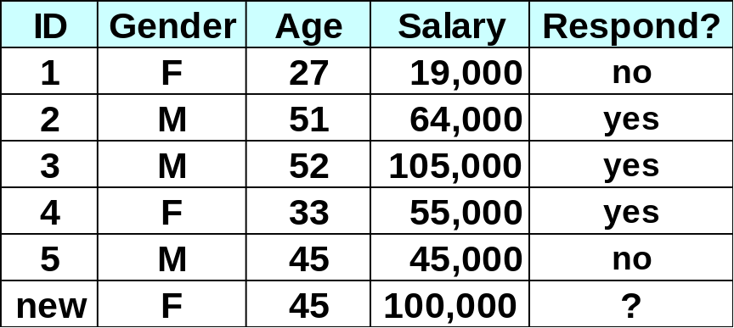
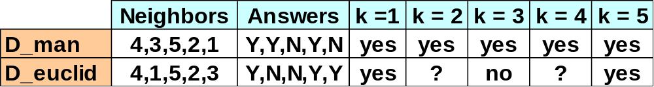
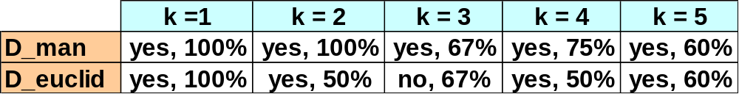
Voting Approach - Example
Will a new customer
respond to solicitation?
Using the voting method without confidence
Using the voting method with a confidence

Slide 25
Combination Functions
Weighted Voting: not so “democratic”
  similar to voting, but the vote some neighbors counts more
  “shareholder democracy?”
  question is which neighbor’s vote counts more?
How can weights be obtained?
  Distance-based
    closer neighbors get higher weights
    “value” of the vote is the inverse of the distance (may need to add a small constant)
    the weighted sum for each class gives the combined score for that class
    to compute confidence, need to take weighted average
  Heuristic
    weight for each neighbor is based on domain-specific characteristics of that neighbor
Advantage of weighted voting
  introduces enough variation to prevent ties in most cases
  helps distinguish between competing neighbors

Slide 26
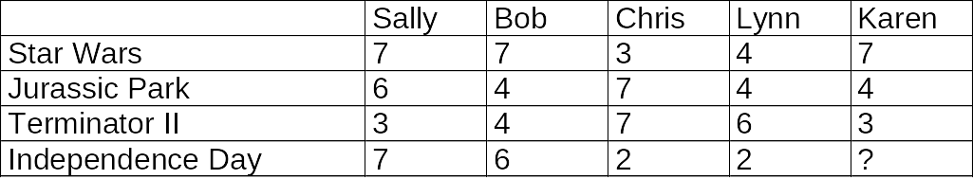
KNN and Collaborative Filtering
Collaborative Filtering Example
  A movie rating system
  Ratings scale: 1 = “hate it”; 7 = “love it”
  Historical DB of users includes ratings of movies by Sally, Bob, Chris, and Lynn
  Karen is a new user who has rated 3 movies, but has not yet seen “Independence Day”; should we recommend it to her?
Will Karen like “Independence Day?”

Slide 27
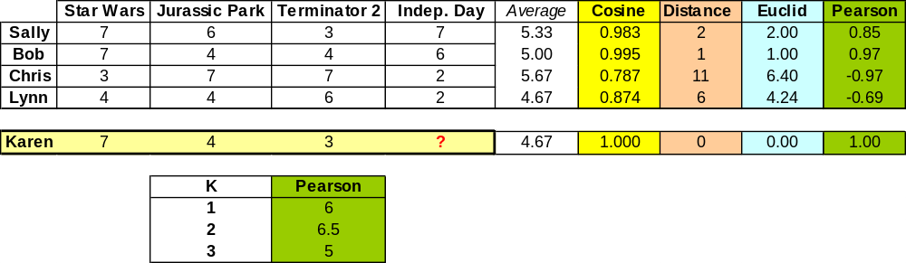
Collaborative Filtering
(k Nearest Neighbor Example)
Prediction
K is the number of nearest
neighbors used in to find the
average predicted ratings of
Karen on Indep. Day.
Example computation:
Pearson(Sally, Karen) = ( (7-5.33)*(7-4.67) + (6-5.33)*(4-4.67) + (3-5.33)*(3-4.67) )
/ SQRT( ((7-5.33)² +(6-5.33)² +(3-5.33)²) * ((7- 4.67)² +(4- 4.67)² +(3- 4.67)²)) = 0.85

Slide 28
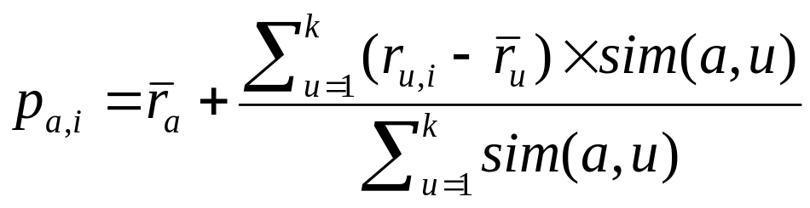
Collaborative Filtering
(k Nearest Neighbor)
In practice a more sophisticated approach is used to generate the predictions based on the nearest neighbors
To generate predictions for a target user a on an item i:
  r_{a} = mean rating for user a
  u₁, …, u_{k} are the k-nearest-neighbors to a
  r_{u,i} = rating of user u on item I
  sim(a,u) = Pearson correlation between a and u
This is a weighted average of deviations from the neighbors’ mean ratings (and closer neighbors count more)

